Slide 1
Store Sales Prediction
VARSHA K

Slide 2
Store Sales Prediction
Objective:
Development of this model is to predict the store sales using detail enter by user. Model will determine the sales of the stores.
To find out what role certain properties of an item play and how they affect their sales by understanding Big Mart sales.
Benefits:
Gives better insight of customers interest for the item.
Find the store sales
Easy to predict the sales information based on user data.

Slide 3
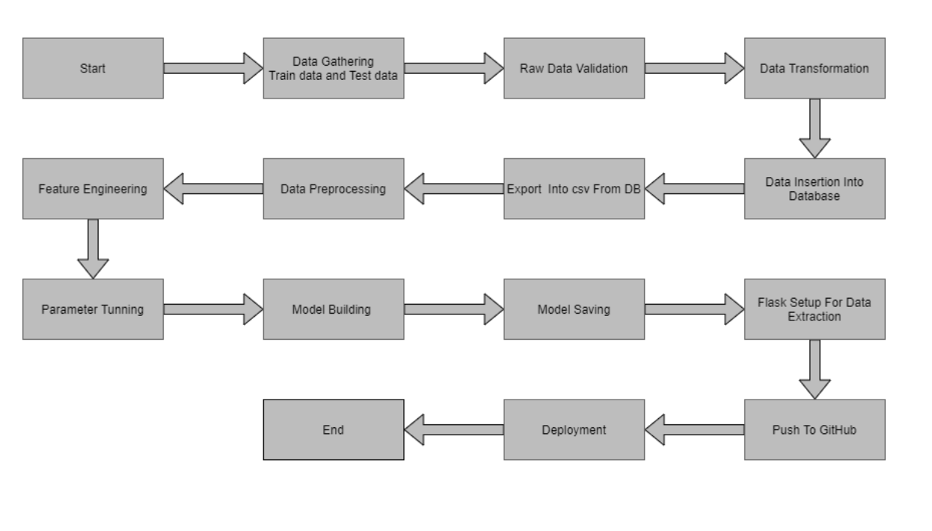
Architecture

Slide 4
Data validation and Data transformation
Item_Identifier: Unique product ID
Item_Weight: Weight of product
Item_Fat_Content: Whether the product is low fat or not
Item_Visibility: The % of total display area of all products in a store allocated to the particular product
Item_Type: The category to which the product belongs
Item_MRP: Maximum Retail Price (list price) of the product

Slide 5
Data validation and Data transformation
Outlet_Identifier: Unique store ID
Outlet_Establishment_Year: The year in which store was established
Outlet_Size: The size of the store in terms of ground area covered
Outlet_Location_Type: The type of city in which the store is located
Outlet_Type: Whether the outlet is just a grocery store or some sort of supermarket
Item_Outlet_Sales: Sales of the product in the particular store. This is the outcome
variable to be predicted.

Slide 6
Data Preprocessing
Training data get from kaggle project in .csv format.
Performing EDA to get insight of data like identifying distribution , outliers ,trend
among data etc.
Check for null values in the columns. If present impute the null values.
Encode the categorical values with numeric values.
Perform Standard Scalar to scale down the values and perform one hot encoding
Save the file as SC.sav

Slide 7
Model Building
We use Linear Regression, RandomForestRegressor for building the model.
Predict the value using this model and find the mean absolute error and mean squared error
Hyper parameter Tuning:
GrideSearchCV used for parameter tuning with estimators values.
KFold used to find the best parameter and used for prediction.
Save the model as random_forest_grid.sav and dump into the google drive.
Load the model for prediction.

Slide 8
Prediction
Train data save in .csv format.
Perform data pre-processing technique on it.
Develop the model and save in the google drive.
Load the model random_forest_grid.sav from the google drive and allow for prediction.

Slide 9
Q & A
Q1) What’s the source of data?
Ans. The data for training is provided by the client in kaggle:
https://www.kaggle.com/brijbhushannanda1979/bigmart-sales-data
Q 2) What was the type of data?
Ans. The data was the combination of numerical and Categorical values.
Q 3) What’s the complete flow you followed in this Project?
Ans. Refer the Architecture section for this.

Slide 10
Q & A
Q 4) What techniques were you using for data pre-processing?
Removing unwanted attributes
Visualizing relation of independent variables with each other and output variables
Removing outliers
Cleaning data and imputing if null values are present.
Converting categorical data into numeric values.
Scaling the data
Q 5) How training was done or what models were used?
Before diving the data in training and validation set we performed clustering over fit to divide the data into clusters. As per cluster the training and validation data were divided. The scaling was performed over training and validation data
Algorithms like Linear regression, Gradient boost and Random forest were used .

Slide 11
Q & A
Q 6) How Prediction was done?
Ans. The tested files are load in to the drive. We pass its data to the best model which we have saved in .sav format and get the prediction.
Q 7) Where the model was deployed?
Ans. When the model is ready, we deploy it in Google cloud platform. This model is an web application where user can enter the data and these data gets extracted in the backend and user gets the prediction result.

